Slide 1
Energy Consumption Analysis for Buildings in San Francisco

Slide 2

Background
The Existing Buildings Energy Performance Ordinance in the City of San Francisco requires commercial and non-residential buildings that meet certain square footage requirements to report energy use and greenhouse gas emission data to the City.

Slide 3
Project Overview
GOAL
GOAL: Our goal was to identify energy usage and greenhouse gas emission trends, patterns, and relationships for commercial and residential buildings in San Francisco
ACTION
ACTION ITEMS: Using the insights from the data, we can advise and modify policies for reducing energy use and greenhouse gas emissions
RESOURCE
RESOURCE: Open Source Data from the City of San Francisco through the Existing Buildings Energy Performance Ordinance Report

Slide 4
Dataset and Cleaning
Data Fields Used
Data Cleaning
Building Name
Floor Area
Property Type
Property Subcategory
Source Energy Use Intensity (EUI) from years 2018-2022 (kBtu/sq-ft)
Total Greenhouse Gas Emissions (GHG) from years 2018-2022 (kGCO2e/sq-ft)
Renamed column headings in dataframe for easy extraction
Dropped rows with “Not Available” or “NaN” values

Slide 5
Question #1
What property subcategory type has the highest source EUI and GHG emissions per square footage in the year 2022? Is there a correlation between GHG emissions and source EUI?

Slide 6
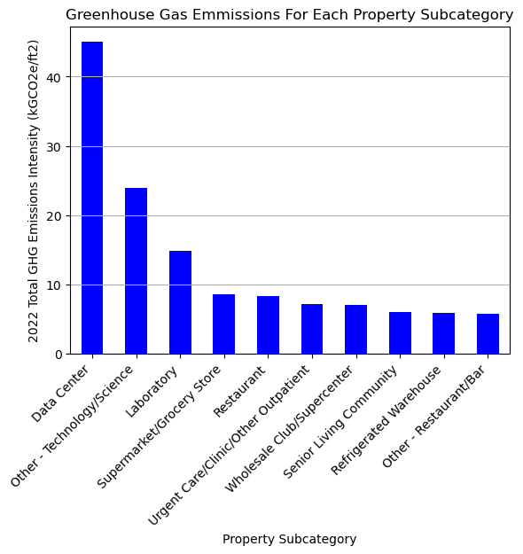
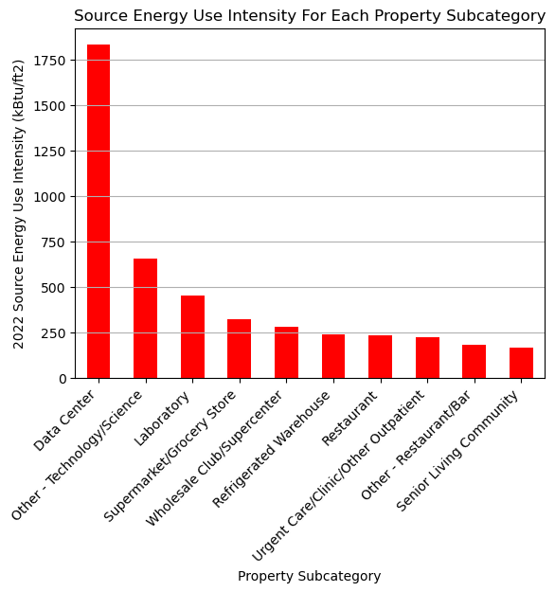
GHG Emissions
Source EUI
PROCEDURE: Used groupby function in pandas to create bar chart broken down by property subcategory
FINDINGS: Highest Source EUI and GHG Emitters are buildings that are continuously in use.

Slide 7
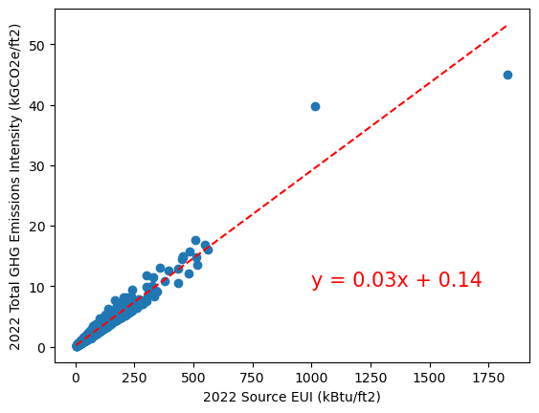
Correlation between GHG and Source EUI
The r-value is 0.948

Slide 8
Conclusions and Analysis
Data center super polluting, find a way to reduce source EUI we will reduce GHG

